Slide 1
Intro to Trustworthy AI Milestone 5 : Trade-offs and Interactions with other verticals in Trustworthy AI
Roseline Polle
Postgraduate, UCL
roseline.polle.19@ucl.ac.uk
Notes:
Assessing and Mitigating Bias and Discrimination in AI
Part I: Ethical, Legal, and Governance aspects of AI Bias and Discrimination
Part II: Technical dimensions of Bias and Discrimination in Supervised Machine Learning

Slide 2
Course Overview
Part I: Ethical, Legal, and Governance
Milestone 1. Notions of Fairness
Milestone 2. Legal and Governance aspects of AI Fairnes
Part II: Technical dimensions in Supervised ML
Milestone 3. Sources, Forms, and Quantification
Milestone 4. Mitigation
Milestone 5. Trade-offs and Interactions with other verticals in Trustworthy AI

Slide 3
EC requirements for trustworthy AI
Ethics guidelines for trustworthy AI (EC): 7 requirements:
Human agency and oversight
Technical Robustness and safety
Privacy and data governance
Transparency
Diversity, non-discrimination and fairness
Societal and environmental well-being
Accountability
https://digital-strategy.ec.europa.eu/en/library/ethics-guidelines-trustworthy-ai

Slide 4
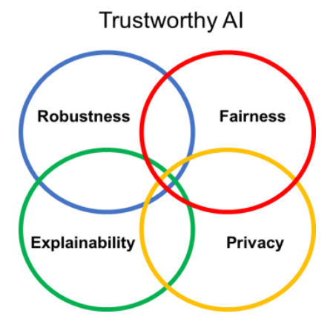
Zoom on four verticals
Privacy: quality of a system to mitigate personal or critical data leakage.
Fairness: quality of a system to avoid unfair treatment of individuals or organizations.
Explainability: quality of a system to provide decisions or suggestions that can be understood by their users and developers.
Robustness: quality of a system to be safe, not vulnerable to tampering

Slide 5
Milestone Overview
Part 1: Theory → Slides + Supporting notebook
Explainability
Privacy
Robustness
Part 2: Explainability Practice Notebook

